Slide 1
Predicting Bank Marketing Campaign Using Machine Learning
CIND-820 Final Project
Omer Mirza - 501077861

Slide 2
Introduction
Understanding Problem Statement
Methodology
EDA-Exploring trends in Data Set
Pre-Processing
Base Model Result
Feature Selection
Results of Feature Selection

Slide 3
Problem Statement
Abstract-Data from a marketing campaign run by Portugal Bank Marketing dataset is examined. The campaign’s aim was to increase customers’ subscription rates to fixed-term deposit. A number of machine learning algorithms are implemented including data pre-processing techniques to answer the question: How can banks successfully market these products in the most efficient way possible and with the highest possible rate of success?
Goal-The classification goal is to predict if the client will subscribe (yes/no) a term deposit(variable y).
To improvise the marketing campaign of bank by analyzing the past sampling data and identify right target customer.

Slide 4
Methodology
Methodology

Slide 5
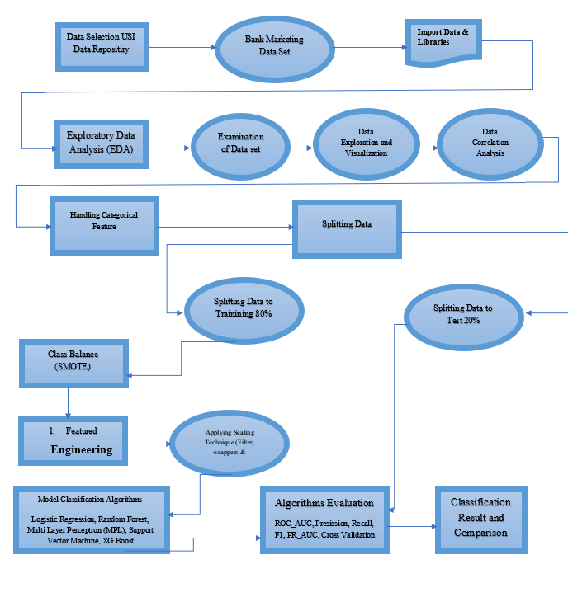
Methodology

Slide 6
Exploratory Data Analysis

Slide 7
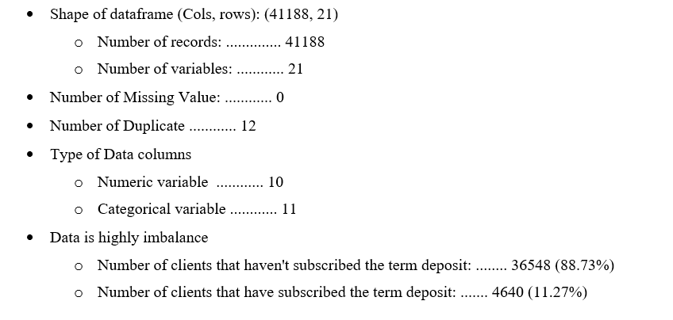
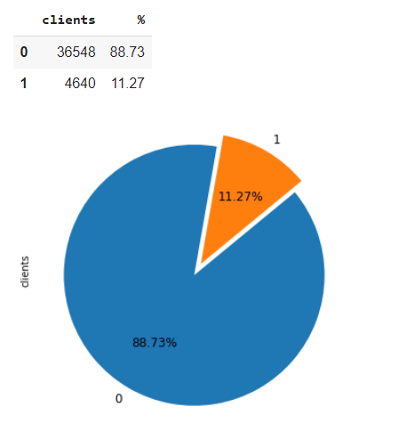
Data shape & Feature
Data is highly Imbalance with on 11.27% of client responding

Slide 8
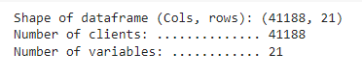
DATA Columns View

Slide 9
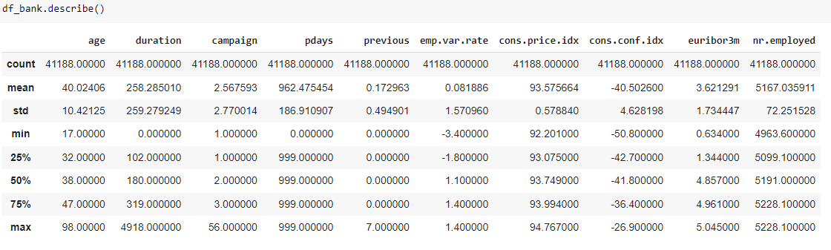
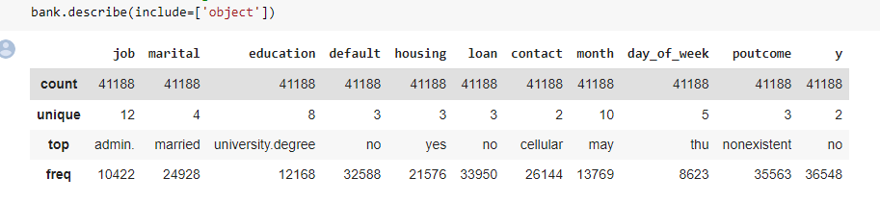
Numeric Value Stats
Categorical Value Stats

Slide 10
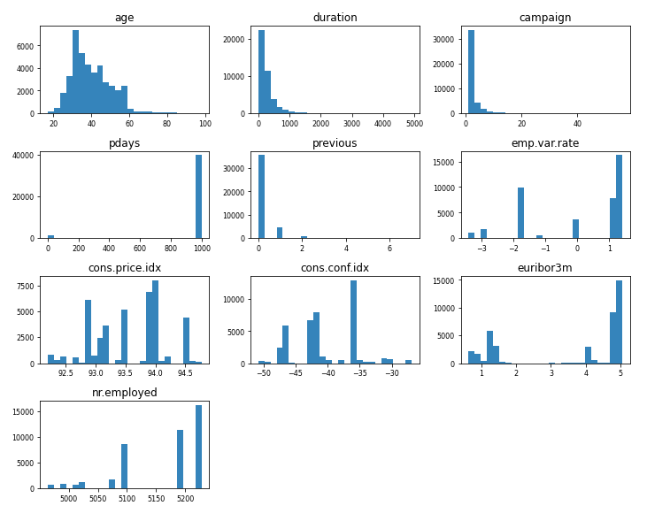
Numerical Data Visualization

Slide 11

Main statistical features of Numerical Value:
1. age: the youngest client has 17 years old and the oldest has 98 years with a median of 38 years whilst the average is 40 years old.
2. pdays: The majority of the clients have the 999 number wich indicates that most people did not contact nor were contacted by the bank. Those are considered to be 'out of range' values.
3. previous: The vast majority were never contacted before
4. emp_var_rate: during the period the index varied from [-3.4, 1.4]
5. cons_price_idx: the index varied from [92.2, 94.8]
6. cons_conf_idx: the consumer confidence level during that period kept always negative with a range of variation of [-51, -27]. These negative values might be explained by the recession that severely affected Portugal due the financial global crisis during that same period the data was recorded
7. euribor3m: there were a huge variation of the euribor rate during the period of analysis [5% to 0.6%]. This abrupt change in euribor together with the negative confidance verified reinforces the hipothesis that this data provides information from a crisis period
8. nr_employed: the number of employed people varied around 200 during the campaign

Slide 12
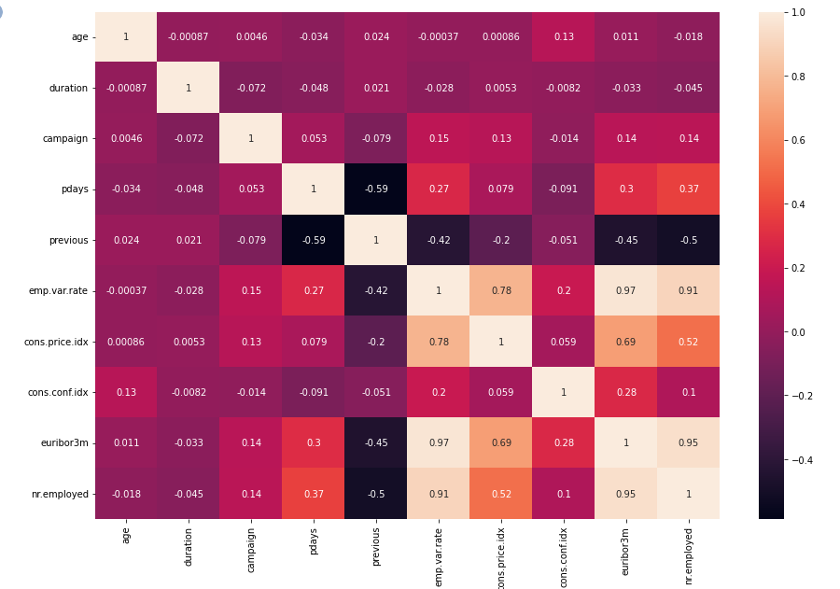
Correlation Matrix of Numerical Data
The social and economic context attributes which is emp.var.rate, euribor3m, nr.employed and cons.price.index have very high correlation. Euribor3m with nr.employed and emp.var.rate with nr.employed with the highest correlation with more than 0.9 value. All columns with a high correlation are to be removed
emp.var.rate- employment variation rate
euribor3m-euribor 3 month rate
cons.conf.idx- consumer confidence index

Slide 13
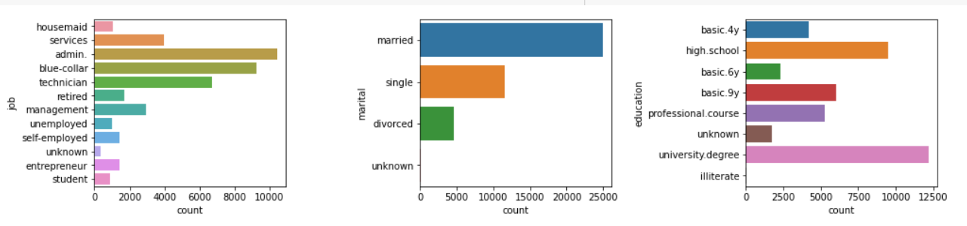
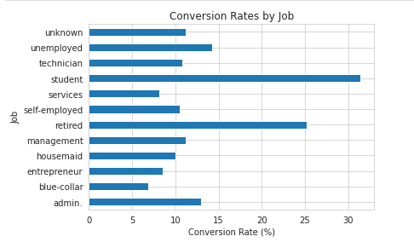
Categorical Data Visualization
Administrative staff and technical specialists opened the deposit most of all. In relative terms, a high proportion of retired and students might be mentioned as well.
Although in absolute terms married consumers more often agreed to the service, in relative terms the single was responded better.
People with university degree as education qualification are the most who have subscribed for the deposits

Slide 14
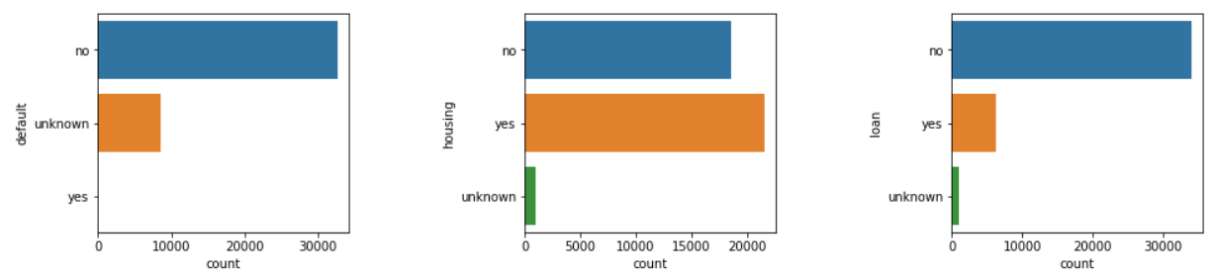
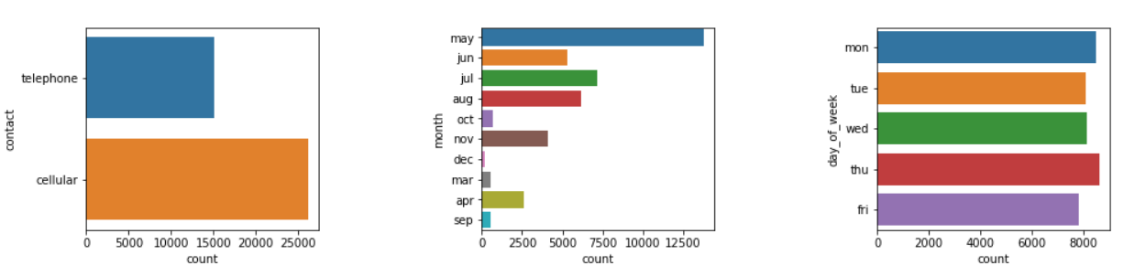
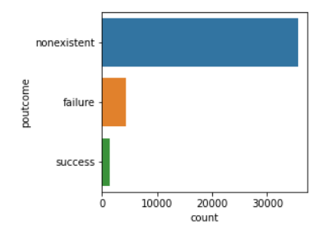
Categorical Data Visualization
People with default status as no are the most one’s who have and have not subscribed for bank deposits.
Best communication channel is mobile phone.
The difference is evident between consumers who already use the services of banks and received a loan.
Home ownership does not greatly affect marketing company performance.
People have been contacted more in the month of May, followed by July, August, June
Day of the week is irrelevant

Slide 15
Main statistical features of Categorical Value:
job: there are 12 types of jobs recordings in wich the 'administrative' role is the most comum with almost 10.5k of the clients
marital: the majority of clients are married with almost 25k records
education: more than 12k people have university degree
default: from all the 41.188 clients, 32.588 don't have any credit in default
housing: almost half of the customers have a housing loan
loan: almost 34k clients don't have any personal loans
contact: cellular is the most preferred choice of contact
month: month of may is the best followed by July, August, June
day_of_week:
poutcome: there is no information about the outcome of any previous marketing campaign

Slide 16
Summary
Target relatively Senior (60+) Age people.
Prioritize those customers to who were the part of the previous campaigns.
Improve the quality of conversation on the phone, and close the deal from the first call so there is no need to contact them many times. “duration” has positive effect on people saying “yes”. This is because the longer the conversations on the phone, the higher interest the customer will show to the term deposit.
Campaigns should run in the spring and summer with an emphasis on May, August, April, and June.
“nr.employed”, which is the number of employees in the bank, has positive effect for turning people to subscribe the term deposit. This can be due to the fact that the more employees the bank have, the more influential and prestigious this bank is.
“euribor3m” is another important variable, which denotes the euribor 3 month rate.
This indicator is based on the average interbank interest rates in Eurozone. It also has positive effect since the higher the interest rate the more willingly customer will spend their money on financial tools.
Employment variation rate (emp.var.rate) has negative influence, which means the change of the employment rate will make customers less likely to subscribe a term deposit.
This makes sense because the employment rate is an indicator of the macroeconomy. A stable employment rate denotes a stable economic environment in which people are more confident to make their investment.
Most influential variables are duration, Age, default, contact, campaign, cons.price.idx, nr.employed, euribor3m, and emp.var.rate.

Slide 17
DATA PROCESSING FOR MODEL BUILDING

Slide 18
DATA Preprocessing for Modelling
Duplicate Data: 12 Duplicate records were deleted
Dropping of column:
Duration – (According to the dataset documentation, we need to remove the 'duration' column because in real case the duration is only known after the label column is known)
Pdays: from attribute information 96% of the value was not previously contacted as there is not enough information for further analysis
Previous: . The attribute has null 35,563 from the total observation of 41,188
Dealing with categorical values: We have 11 Category attributes, using one-hot encoder will increase number of columns to more than 50 and considering the size of data I will be using Label encoding
Outlier Handling: One outlier from campaign column is removed

Slide 19
DATA Preprocessing for Modelling
Splitting of data in Train and Testing Set: For the experiments, an 80:20 ratio of the data set was chosen, i.e., the training data uses 80% of full data set, and 20% is used for testing
Use of Standardization: use of scikit-learn machine learning (ML) functions for standardization of data but has no impact on dataset
Normalization: which is Min-Max Scalar technic, will not work as this data doesn't need to suppress outliers, as outliers are already dropped.
Application of Smote for Class Imbalance: Since only 11.6% of our data set has the positive response, the imbalance has to be handled. Thus, resampling techniques are used to improve the classification accuracy. Applied SMOTE to the entire dataset will result in data leakage.
Before SMOTE the shape of y_train was for 0 class “no” 16,270 and 1 class “yes” 1,595
After SMOTE the shape of y_train was for 0 class “no” 16,270 and 1 class “yes” 16,270

Slide 20
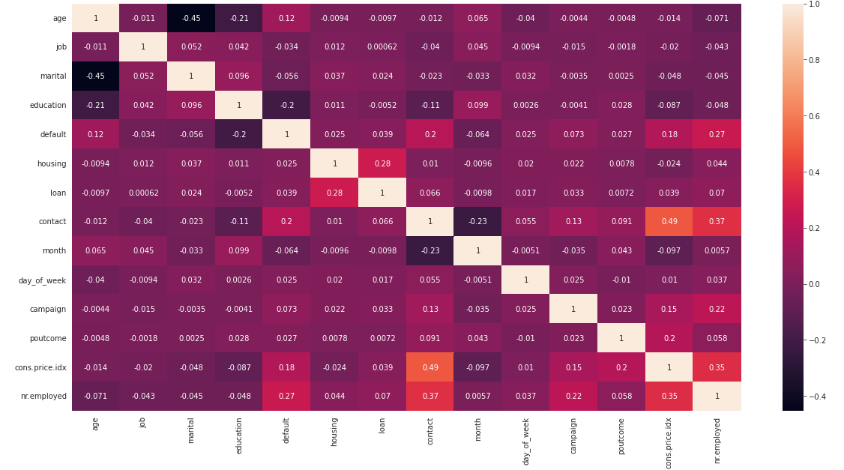
Correlation Matrix after Preprocessing Data
No Attribute has any Significant Correlation

Slide 21
Classification Algorithms

Slide 22
Modelling - Classification algorithms – Five classification algorithms have been selected to predict future subscription:
Classifier Algorithms | Advantages | Non-Advantages
Logistic Regression (LR) | Easy to implement, interpret, and very efficient to train. Less prone to overfitting Efficient for binary and linear classification problems. | Poor performance on non-linear data Poor performance with irrelevant and highly correlated features Not very powerful algorithm High reliance on proper presentation of data.
Multi-Layer Perceptron (MPL) | Capability to learn non-linear models. Capability to learn models in real-time (on-line learning) | requires tuning a number of hyperparameters Sensitive to feature scaling. total parameters can grow to very high

Slide 23
Modelling - Classification algorithms – Five classification algorithms have been selected to predict future subscription:
Classifier Algorithms | Advantages | Non-Advantages
Support Vector Machine (SVM) | Performs well in Higher dimension Best algorithm when classes are separable. Outliers have less impact SVM is suited for extreme case binary classification. | Slow: For larger dataset, it requires a large amount of time to process. Poor performance with Overlapped classes Poor performance with Overlapped classes Selecting the appropriate kernel
Random Forest (RF) | Reduced error Good Performance on Imbalanced datasets Handling of huge amount of data Good handling of missing data Little impact of outliers No problem of overfitting: Useful to extract feature importance (we can use it for feature selection) | Features need to have some predictive power else they won’t work Predictions of the trees need to be uncorrelated Appears as Black Box

Slide 24
Modelling - Classification algorithms – Five classification algorithms have been selected to predict future subscription:
Classifier Algorithms | Advantages | Non-Advantages
XGBOOST | 1. Less feature engineering required 2. Feature importance can be found out 3. Fast to interpret 4. Outliers have minimal impact. 5. Handles large sized datasets well. 6. Good Execution speed 7. Good model performance (wins most of the Kaggle competitions) 8. Less prone to overfitting | 1. Difficult interpretation , visualization tough 2. Overfitting possible if parameters not tuned properly. 3. Harder to tune as there are too many hyperparameters.

Slide 25
Baseline Algorithm Result

Slide 26
Baseline Classification Algorithm Without Feature Selection - Results
The result shows that Logistic Regression highest number of TP, however its also has highest number of FP
Considering all matrix it seems that XGBoost has the best result followed by MLP and RF

Slide 27
Feature Selection Result

Slide 28
Feature Selection Technics
Feature Selection is the process where you automatically or manually select those features which contribute most to your prediction variable or output in which you are interested in.
Having irrelevant features in your data can decrease the accuracy of the models and make your model learn based on irrelevant features.
How to select features and what are Benefits of performing feature selection before modeling your data?
Reduces Overfitting: Less redundant data means less opportunity to make decisions based on noise.
Improves Accuracy: Less misleading data means modeling accuracy improves.
Reduces Training Time: fewer data points reduce algorithm complexity and algorithms train faster.
The feature selection algorithms can be divided in to three categories:
filter method,
wrapper method, and
embedded method.

Slide 29
Feature selected by Featuring Techniques
Classification with Wrapper Feature Selection - Forward feature selection did not reduced any more features and retains all 14 columns as the baseline models

Slide 30
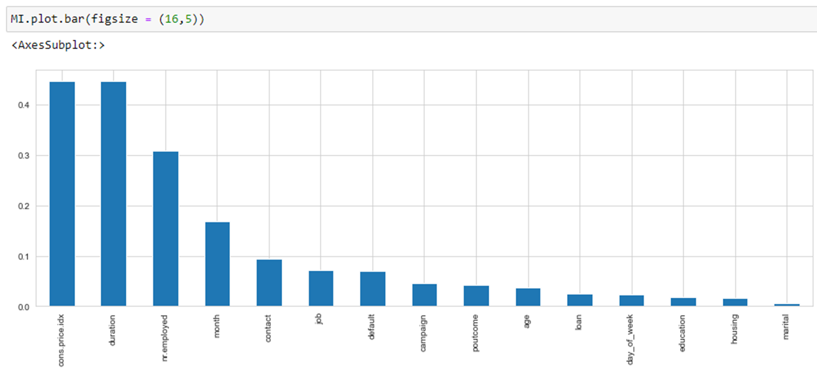
Results of the feature selection
Found the most powerful features that were selected by Filter Method of Mutual Information Gain, which ranked based on evaluation of the gain of each variable in the context of the target variable.
The model ranked accordingly to importance with the best 5 feature which are 'cons.price.idx', 'duration', 'nr.employed', 'month', and 'contact'.

Slide 31
CONFUSION MATRIX
CONFUSION MATRIX | Logistic Regression (LR) | Multi-Layer Perceptron (MPL) | Support Vector Machine (SVM) | Random Forest (RF) | XG Boost (XGB).
Baseline Model with 15 Features
True Positive (TP) | 619 | 302 | 560 | 589 | 475
True Negative (TN) | 5567 | 6829 | 6277 | 6299 | 6599
False Positive (FP) | 1695 | 433 | 985 | 963 | 663
False Negative (FN) | 354 | 671 | 413 | 384 | 498
Classification with Filter Methods for Feature Selection - Mutual Information
True Positive (TP) | 648 | 565 | 593 | 558 | 498
True Negative (TN) | 5651 | 5917 | 6189 | 6423 | 6577
False Positive (FP) | 1611 | 1345 | 1073 | 839 | 685
False Negative (FN) | 325 | 408 | 380 | 415 | 475
Classification with Wrapper Feature Selection - Forward feature selection
True Positive (TP) | 619 | 302 | 560 | 588 | 475
True Negative (TN) | 5567 | 6829 | 6277 | 6249 | 6599
False Positive (FP) | 1695 | 433 | 985 | 1013 | 663
False Negative (FN) | 354 | 671 | 413 | 385 | 498
Classification Embedded Methods -LASSO Regularization (L1):
True Positive (TP) | 608 | 511 | 604 | 594 | 506
True Negative (TN) | 5532 | 5867 | 6040 | 6013 | 6466
False Positive (FP) | 1730 | 1395 | 1222 | 1249 | 796
False Negative (FN) | 365 | 462 | 369 | 379 | 467
The result shows that Logistic Regression highest number of TP, however its also has highest number of FP

Slide 32
Classification Model Evaluation - Feature Selection
Scale | Highest | Lowest | Average

Slide 33
Specificity, Sensitivity & Risk
Scale | Highest | Lowest | Average

Slide 34
ROC_AUC Training and Test Result
Scale | Highest | Lowest | Average

Slide 35
Result of Feature Selection
Classification with Wrapper Feature Selection - Forward feature selection did not reduce any more features and retains all 14 columns as the baseline models as shown in table 8.1
XGBoost Performs best in both Classification with Filter Methods for Feature Selection - Mutual Information and Classification Embedded Methods -LASSO Regularization (L1) (Table 8.6)
Logistic Regression perform the worst of all 5-classification model with highest recall in both baseline and both Classification with Filter Methods for Feature Selection - Mutual Information and Embedded Methods -LASSO Regularization (L1)
Both Multi-Layer Perceptron (MPL) and Support Vector Machine (SVM) takes longer time to run
Multi-Layer Perceptron (MPL) performed better without feature selection
Random Forest performed better under Classification with Filter Methods for Feature Selection - Mutual Information
Support Vector Machine (SVM) performed better Classification with Filter Methods for Feature Selection - Mutual Information
Random Forest is the most efficient model in terms of time to run

Slide 36
XGBOOST Comparison
Scale | Highest | Lowest | Average

Slide 37
Thank You
Code and documentation for this project on GitHub repository as following
https://github.com/omerbmk/CIND-820-OmerMirza/blob/main/CIND_820_Bank_Telemarketing_Complete_Code.ipynb

